Slide 1
Using IoT to simulate
Smarthouse Environment
Presenter: Le Thanh Duc
Neptun code: YZ49Y8
Supervisor: Dr. Illés Zoltán

Slide 2
ABOUT THE GOALS OF THIS STUDY AND PRESENTATION
Notes:
In general, the aim of this project is to use Internet of Things to turn life at home smarter, to make devices listen to what we want and act correspondingly. Those sensors are used in this thesis are designed to gather information about the environment around the building, such as temperature and humidity, and note if there's movement, as well as any changes in it. For instance, if you want a particular theme to be automatically applied at a particular time of day or night, this will also provide you with the ability to allow that.

Slide 3
Used Programming Language
HTML/ CSS, Javascript, PHP
C/C++
Shell commands

Slide 4
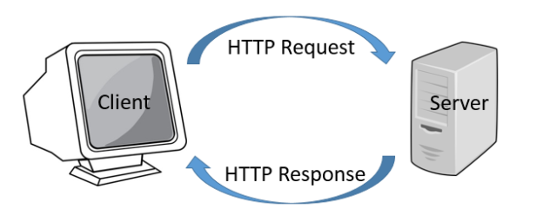
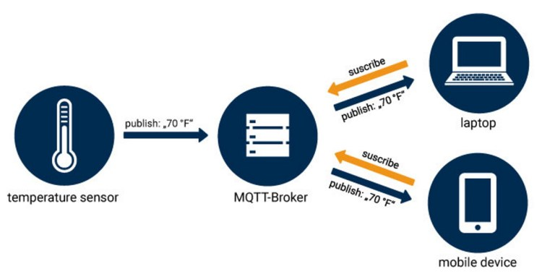
Required Tools
HTTP
MQTT
GET/PUT/POST/DELETE
Machine-To- Machine communication
Notes:
MQTT- Message Queueing Telemetry Transport, is a publish-subscribe lightweight messaging protocol. It is intended for use in situations involving machine-to-machine communication and the Internet of Things. MQTT provides connections for remote areas that need a small code footprint or have very limited network bandwidth. Clients interact with a server, which is referred to as a "broker”. Any client may connect to the broker and either publish or subscribe to topics. Topics are classes of information that are coordinated and shared. A client subscribes to a subject, and when the broker receives a message published by a client within that topic, it distributes the information contained in the message to all topic subscribers. The publisher and client do not need to know eachother. A MQTT link does not close after each request, leaving the communication channel open and incurring the overhead of opening and closing connections.

Slide 5
Required Devices
Raspberry Pi 3
Node MCU- ESP8266
ESP32 CAMERA
Sonoff 4CH Switches
Humidity Sensor (HR202)
Motion Detector Sensor(SR505)

Slide 6
Deployment Scenario

Slide 7
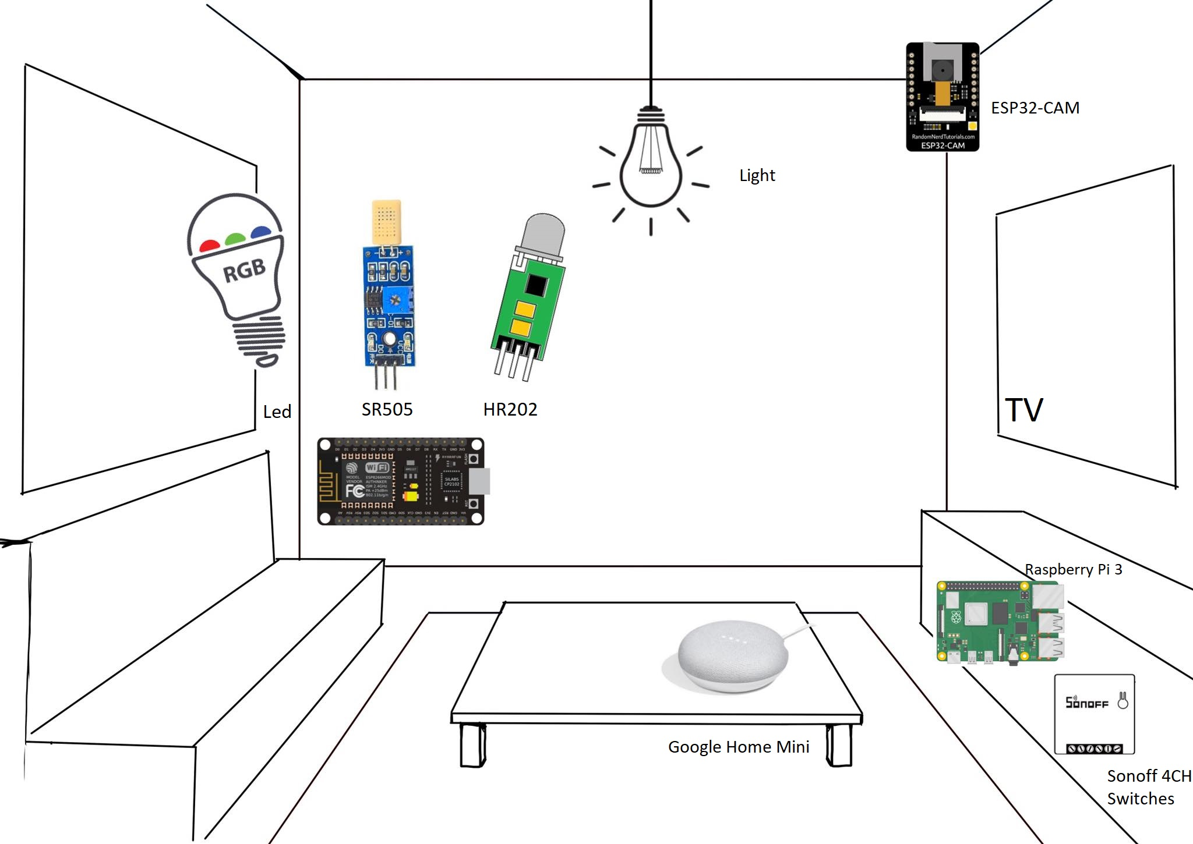

Slide 8
Let’s test it out !

